Slide 1
CUAE Developer Workshop
Seth Call, call@cisco.com
Senior Software Engineer and Developer Evangelist

Slide 2
Session Objectives
At the end of this session, the participant should be able to:
Understand what a developer gains by using the CUAE.
Explain the architecture and purpose of the CUAE.
Conceptualize new potential applications.

Slide 3
What is the CUAE?
The Cisco Unified Application Environment is a development platform for IPT applications hosted within Cisco Unified Communications Manager deployments.
  A place to rapidly develop, deploy, manage IPT applications.
CUAE is an umbrella term for 3 discrete products:
  Cisco Unified Application Server
  Cisco Unified Media Engine
  Cisco Unified Application Designer

Slide 4
Customer Perception of the CUAE
The CUAE allows one to
  HOST applications at an enterprise level (CUAS/CUME)
  DEVELOP such applications rapidly (CUAD)
What kind of customers do these features attract?
  Cisco Unified Communications Manager deployments that want to go beyond dial tone.
  “I want to HOST applications that others have developed”
  Development shops that want to sell IPT applications.
  “I want to DEVELOP applications that others will host”
  Cisco Unified Communications Manager deployments with a substantial IT department
  “I want to HOST and DEVELOP my own applications”

Slide 5
Why is it valuable?
Rapid Development & Deployment
Management of Applications and the Platform
The concept of IP Telephony is removed from underlying protocol
Rich media capabilities
Abstraction from CUCM version changes
CUCM protocols

Slide 6
Major Components of the CUAE
CUAS and CUME are the two server-side components which act as a protocol hub that custom-built applications can easily leverage.
Application Server
  Cisco Unified Communications Manager voice protocols
  Cisco Unified Communications Manager data protocols
  Generic data protocols
Media Engine
  RTP stream processing

Slide 7
Major Components of the CUAE (cont.)
The CUAD is an integrated development environment (IDE) that runs on a developer’s PC.
  Tightly integrated to the CUAS—single-click deployment of applications means minimal delay in development cycle, resulting in efficient developers.
  Drag-and-drop, graphical programming language for rapid and clear construction of application logic.
  Developer flexibility via the freedom to drop into .NET code within the CUAD to satisfy the most rigorous of application requirements.
  Modern features associated with modern IDEs, such as compile-time checking and runtime-debugging.

Slide 8
What are some of the APIs available?
The Application Designer abstracts both simple and complex protocols to a straightforward design pattern.
  Call Control: SIP, H.323, SCCP, JTAPI 1st and 3rd party
  Cisco CUCM: IP Phone Services, DeviceListX, AXL-SOAP, Extension Mobility, SNMP
  Data Interfaces: Web Services (client), SQL (client), LDAP (client), SMTP (client), HTTP (client and server)
  Any extension created by a developer

Slide 9
What Can the Media Engine Do?
Playing Text-to-speech, wav/vox files.
Recording streams to wav/vox files.
Speech Recognition (via Nuance)
Voice Fingerprinting (via PerSay)
Conferencing of multiple streams
Seamless transcoding of G.711, G.723, G.729, …
DTMF Collection

Slide 10
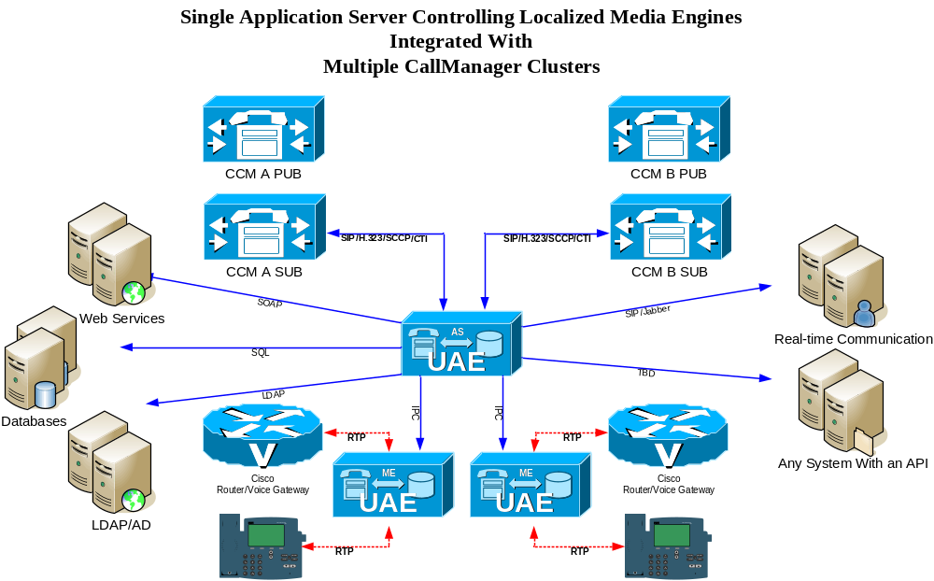
Deployment Architecture

Slide 11
What can Communications Manager telephony protocols do?
CUAE performs 1st party call control using protocols which CUCM has implemented in specific ways (SIP, H.323, SCCP, CTI). CUAE appears within CUCM as a device—such as an SIP Trunk, H.323 Gateway, CTI Route Point, etc…
Any of these protocols allow an application to make and receive calls. Extended features, such as redirecting, transferring, shared-line, conferencing vary per protocol.
Bottom-line: A developer of the CUAE does not program to the protocol layer. A single application inherently supports each protocol!

Slide 12
What can the supported CUCM APIs do?
AXL-SOAP
  Dynamic changes of CUCM database. In general, if you can change it in CUCMadmin, then you can change it using AXL.
JTAPI
  Real-time device information for IP Phones. If you need to know something is happening on a particular phone, or affect changes on the call as a 3rd-party…
Extension Mobility.
  Most common use of EM API is to create new interfaces for device profile login/logout outside of context of an IP Phone service.
Real-time device cache
  CUAE caches device info for all devices so that mapping of disparate device information becomes simple for developers (Device Name, IP address, line numbers, etc).

Slide 13
Is There an API?
A customer may ask for an application which needs to communicate with an outside system that the CUAE does not support out-of-the-box.
  There is only one question that must be asked “Is there an API that the CUAE can integrate into”?
  One can answer this question generically: If .NET code can be created which talks to the API, then an extension can be built for the CUAE.
  The only real complexity is gauging how difficult the integration effort would be. Generally one would leave that assessment to a CUAE application developer.

Slide 14
Why is the CUAE Different?
The CUAE is the most comprehensive IPT application platform, but why?
Enterprise-level, application platform and runtime.
Time of development and testing is minimized due to concise and powerful design patterns enforced by the CUAD.
Total control of calls and media audio streams.
Other IPT platforms exist, but none come close to feature set and level of unification with CUCM
Completely extensible.
  There isn’t native support for something?? Build it!

Slide 15
Why is the CUAE Different?
Applications can be built much more quickly (CUAD) and to a very high level of quality (Communications Manager APIs can change break applications--let the CUAS do the low-level heavy lifting and protect your app).
This results in more applications for customers and real opportunity for developers in the Cisco community!

Slide 16
Make Partners/Developers Successful
The barrier to development for CUAE/CUCM should be as close to zero as possible.
  Traditionally this has been difficult with a ‘hardware’ company.
In Summer 2007, an SDK download will become available for the CUAE, CUCM, CUPS, and IP softphone. At this time CUAE will also support CUPS integration, adding a new level of mobility and presence to applications.
  Our goal is to make these downloads as close to free as possible, as well as to enable virtualization for testing, development, demos, and trials.

Slide 17
CUAE Language Elements
On to development…

Slide 18
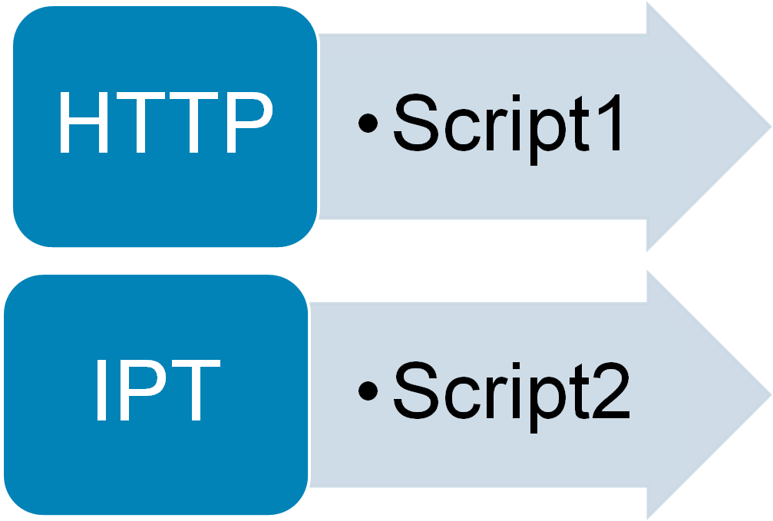
The Basics – Scripts & Events
A script is roughly equivalent to a process.
  The stimuli of a script are events. Scripts both start and awake from sleep states due to occurrence of events.

Slide 19
The Basics – Triggering and NonTriggering Events
Events are processed or ‘handled’ by functions.
public Script1() // cstr
{
void* triggerHandler = IncomingCall;
void* callHungup = RemoteHangup;
}
public void IncomingCall(object[] params)
{
// process incoming call
}
public void RemoteHangup(object[] params)
{
// process hangup by remote party
}
VOIP
  Script1

Slide 20
The Basics – Actions
Actions are methods with multiple inputs and outputs.
  A number of prepackaged actions exist
  One can create their own actions and incorporate them into the toolbox.
public void IncomingCall(object[] params)
{
// process incoming call
int connId = CUAELib.AnswerCall();
string name = CustomLib.FetchCallerName();
CUAELib.Play(connId, “Enter pin” + name);
}
VOIP
  Script1

Slide 21
The Basics – Global & Local Variables
Variables can exist in just a function or across all functions.
int g_connId = 0;
public void IncomingCall(object[] params)
{
// process incoming call
int localConnId = CUAELib.AnswerCall();
g_connId = localConnId;
}
Public void RemoteHangup(object[] params)
{
// process remote hangup
CUAELib.DeleteConnection(connId);
}
VOIP
  Script1

Slide 22
Common Tasks Made Simple - Design
Asynchronous patterns have already been implemented.
Application Designer enforces the Action/Event model
      Overall execution of application flows as protocol providers raise events
      Synchronous action execution
      Asynchronous action execution (thread is released while provider operates on the action, callback eventually fires)
      Asynchronous action with synchronous wrapper (thread is released as well, although script blocks execution while action executes)

Slide 23
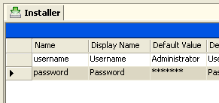
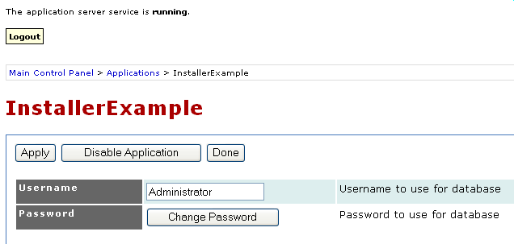
Common Tasks Made Simple - Config
Making an application configurable by the administrator is driven by simple declarations of configuration items.
The administrator can then configure these items on the web portal.

Slide 24
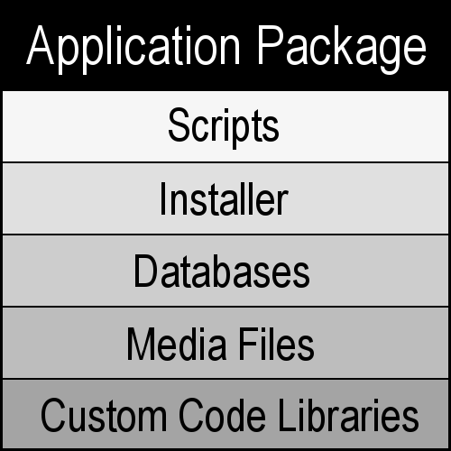
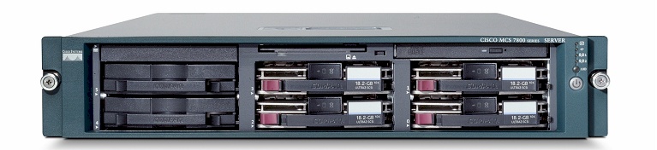

Common Tasks Made Simple - Media
Media Resources come in two forms
  Audio file (.wav or .vox)
  Voice Recognition Grammar file
Audio files are provisioned from the Application Server to all configured Media Engines.
Application Server
Media Engines

Slide 25
Common Tasks Made Easier– Databases
Database installer files are used to define databases that are guaranteed to be available on the Application Server.
  Upon deploying application, database scripts are executed against embedded MySQL database
  Script simply consists of SQL defining tables, commands (CREATE TABLE, INSERT, UPDATE, DELETE, etc)
Internal databases such as these were designed to give developers to provide a powerful tool for coordination of state among scripts.
Storing content in a database provides a ‘way in’ to the CUAE for web development.

Slide 26
Common Tasks Made Simple - Deploy
One-click Deployment
  The Application Designer can bundle, deploy, install, and configure an application in one-click.
    The file created by the designer is essentially a tar file with all the necessary pieces of the application bundled.
    An administrator can take this same tar file and deploy it to their own machine…
  The Application Designer ships with command-line tools to also automate this process if one has specialized installation needs.

Slide 27
Common Tasks Made Simple - Extending
Extending the system is done by protocol providers, custom actions, and custom types.
  Extending is done with .NET. Other languages are possible, but more difficult (explained later).
  Actions and provide ways to create simple building blocks.
  Providers are a mechanism to integrate the CUAE with arbitrarily complex protocols.
  Out-of-the-box features are built with the same extension system.

Slide 28
Deployment Architecture Again

Slide 29
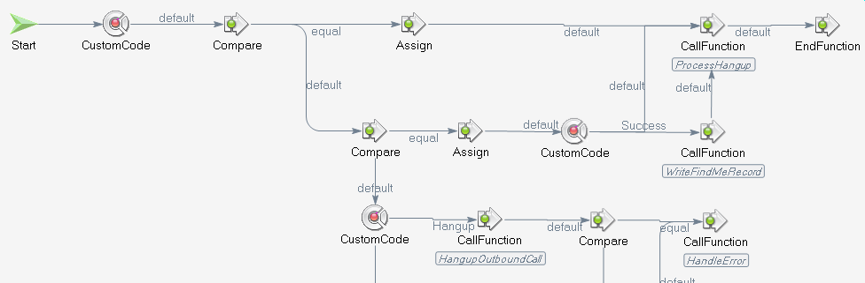
Development Environment – Drag & Drop
Simplest: Drag and Drop of Prebuilt Actions & Events
  Every action and event is parameterized, predefined code.

Slide 30
Development Environment – Integrating APIs
The underlying code of the method and the action ‘build block’ used in the script have a large amount of separation.
  The method, and the input and output arguments of the method, can have their display name changed with no impact.
  For provider actions and events, it is possible to accept any number of types (string, integer, etc) for a given input or output.
Understanding the script model lets the provider creator leverage the concept of sessions to allow an application developer to inherently correlate protocol traffic.

Slide 31
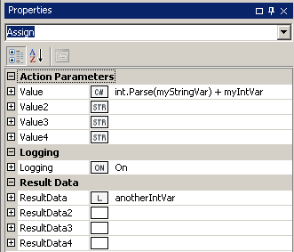
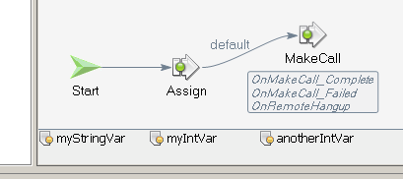
Development Environment - Snippets
C# can be used as a ‘one-liner’ for the input parameters of actions.
  The C# statement can reference any local or global variable.
  There is a default set of usings and referenced assemblies.

Slide 32
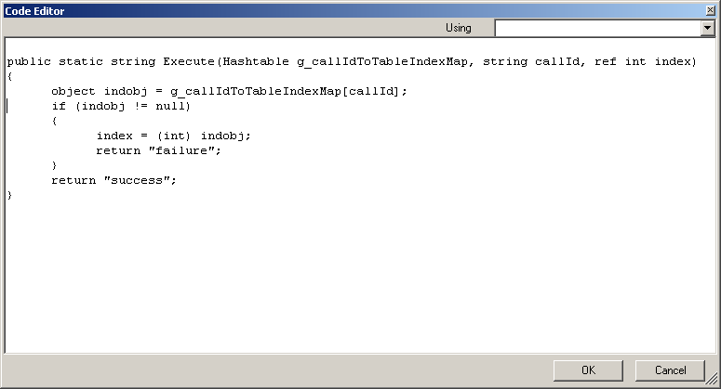
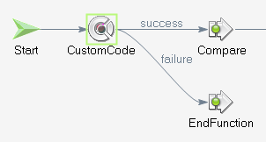
Development Enviroment – Inline Code
Custom Code blocks allow multiple lines of code to be dropped in-line into the flow of the script.
  Local and Global variables are also available to the C# code.

Slide 33
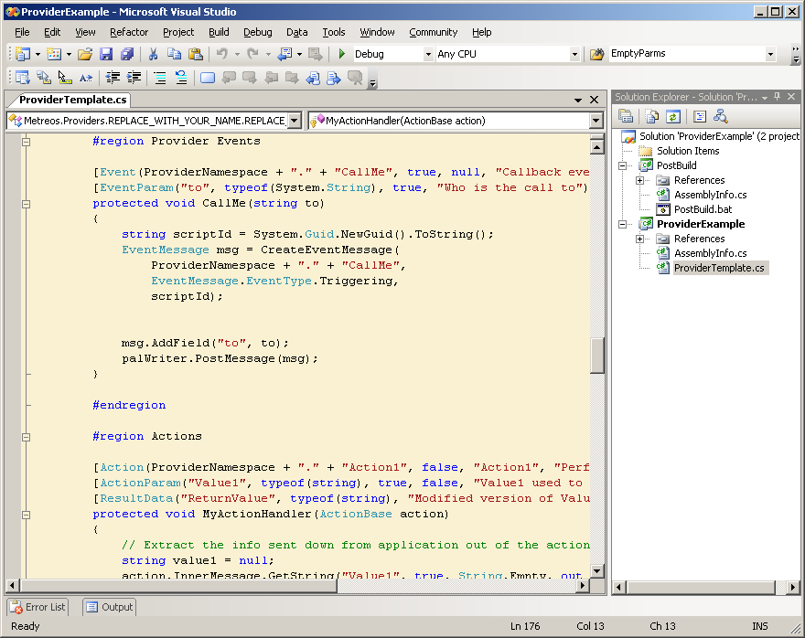
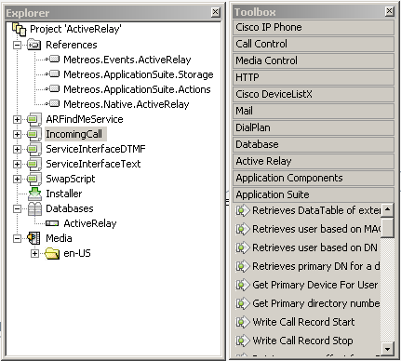
Development Environment
Protocol Providers, Actions, and Types offer a means to extend the system with virtually anything buildable in.NET.

Slide 34
Development Environment - Limits
Development in technologies other than .NET requires a level of indirection via a Windows service.
An example of this is our own JTAPI implementation.
  A Java-based service
  Service communicates with a provider that mostly acts as a message proxy to bridge the Java service and scripts.
To facilitate deployment of this pattern, one can bundle an arbitrary number of services with a provider.
  The services will be installed automatically on the server when the provider is installed.
  We always aim to minimize the amount of one-off environmental changes one has to make to the CUAE platform.

Slide 35
Official Support
Platform support is offered via UCSS (TAC).
  I’m HOSTing an Application Server and it’s not working right. You can get help with:
    Call related issues
    Media related issues
    Platform management and OS issues
Developer support is offered via the Developer Services Program (AS-DS).
  I’m DEVELOPing an application and it’s not working right. You can get help with:
    All the other things that can go wrong!

Slide 36
Discovering & Building the Killer App
Your practice knows the business processes of your customers.
  The CUAE is the tool to build applications which streamline those processes.
Examples always help…

Slide 37
Salesforce.com
Hypothetical Customer
  Uses salesforce.com to manage customer relations.
  Has a small, focused sales team.
    Call center software has some great features, but many are overkill and the few that make sense to justify the price.
  Has resellers that have variable amounts of inventory on hand.
  Fire drill: customer call in wanting product .

Slide 38
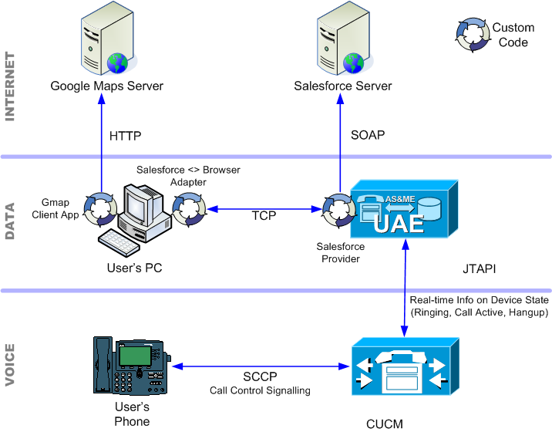

Salesforce & Google Maps + Voice

Slide 39
Future of the CUAE
The Cisco Developer Network will provide a natural place for developers to congregate for documentation and forums.
‘As free as possible’ downloads of the CUAE, CUCM, and other related technologies.
Continued focus on:
  Virtualization
  Testing
  Web management
New focus on:
  Language independence

Slide 40
Session Objectives Summary
In this session, you:
Explained the architecture and purpose of the CUAE.
Explained why the CUAE is unique.
Understood at high level what the CUAE can do.
Conceptualized new potential applications.

Slide 41
Key Takeaways
The CUAE was architected from the ground up to support any Communications Manager deployment and to satisfy enterprise-level application requirements.
The CUAE is by far the most comprehensive platform for the development, debugging, testing, and execution of Cisco Unified IPT applications.
Applications built on the CUAE can easily leverage a wide range of telephony, Communications Manager-specific, and data APIs, as well as be extended to support non-default APIs.
To understand potential new applications, it is very advantageous to have a high-level understanding of telephony, Communications Manager-specific, and data APIs that the CUAE can leverage.

Slide 42

Q and A
Resource Pointers:
  CUAE Free SDK Software: http://www.cisco.com/web/developer/cuae/content/download.html
  Yahoo Groups:
  http://tech.groups.yahoo.com/group/cuae-dev/
  IRC Channel:
  irc.dal.net #cuae
Seth Call, call@cisco.com
Senior Software Engineer & Developer Evangelist

